Slide 1
Managing Multiple Nodes
TBD
Notes:
This section's goal is to have you bootstrap another node, this time a web server, and add it to the proxy members.

Slide 2
Objectives
After completing this module, you should be able to
Bootstrap an additional node
Update the run list for a new node
Run chef-client on a node
Verify that the proxy server delivers traffic to both web server nodes
Notes:
TBD: Need more objectives?

Slide 3

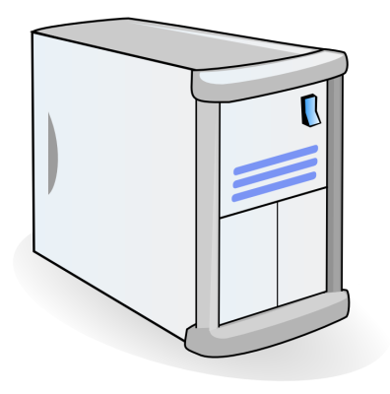
Managing User Traffic
You already configured the proxy server and one web server node.
In this module you'll add another node to the proxy server's list a web server's it is serving.
Internet
Web Server (Existing)
Proxy Server
Web Server (New)
Notes:
After completing this module, you will have configured three nodes:
Node 2: The proxy server
Node 1: A web server
Node 3: Another web server

Slide 4
Lab: Another Web Node
Bootstrap a new node
Update the run list of the new node to include the web server cookbook
Login to that system and run chef-client
Verify that the node's web server is functional
Notes:
Now its time to create a third node. The third node will be the second web server node.
We will provide you with a new node for the following exercise.
Instructor Note: Assign each student the IP address of their new node (node3).

Slide 5
Lab: Bootstrap the New Node
$ knife bootstrap FQDN -x USER -P PWD --sudo -N node3
Connecting to ec2-54-210-86-164.compute-1.amazonaws.com
ec2-54-210-86-164.compute-1.amazonaws.com Starting first Chef Client run...
ec2-54-210-86-164.compute-1.amazonaws.com Starting Chef Client, version 12.3.0
ec2-54-210-86-164.compute-1.amazonaws.com resolving cookbooks for run list: []
ec2-54-210-86-164.compute-1.amazonaws.com Synchronizing Cookbooks:
ec2-54-210-86-164.compute-1.amazonaws.com Compiling Cookbooks...
ec2-54-210-86-164.compute-1.amazonaws.com [2015-09-16T17:36:14+00:00] WARN: Node node3 has an empty run list.
ec2-54-210-86-164.compute-1.amazonaws.com Converging 0 resources
ec2-54-210-86-164.compute-1.amazonaws.com
ec2-54-210-86-164.compute-1.amazonaws.com Running handlers:
ec2-54-210-86-164.compute-1.amazonaws.com Running handlers complete
ec2-54-210-86-164.compute-1.amazonaws.com Chef Client finished, 0/0 resources updated in
Notes:
Bootstrap the new node and name it node3.

Slide 6
Lab: Verify the New Node
$ knife node show node3
Node Name: node3
Environment: _default
FQDN: ip-172-31-0-127.ec2.internal
IP: 54.210.86.164
Run List:
Roles:
Recipes:
Platform: centos 6.6
Tags:
Notes:
Verify that you bootstrapped the node.

Slide 7
Lab: Set the Run List
$ knife node run_list add node3 "recipe[apache]"
node3:
run_list: recipe[apache]
Notes:
Set the run list for this node by running the apache cookbook's default recipe.

Slide 8
Lab: Converge the Run List
$ knife ssh "*:*" -x USERNAME -P PWD "sudo chef-client"
ec2-54-175-46-24.compute-1.amazonaws.com Starting Chef Client, version 12.3.0
ec2-54-210-192-12.compute-1.amazonaws.com Starting Chef Client, version 12.3.0
ec2-54-210-86-164.compute-1.amazonaws.com Starting Chef Client, version 12.3.0
ec2-54-175-46-24.compute-1.amazonaws.com resolving cookbooks for run list: ["apache"]
ec2-54-210-86-164.compute-1.amazonaws.com resolving cookbooks for run list: ["apache"]
ec2-54-210-86-164.compute-1.amazonaws.com Synchronizing Cookbooks:
ec2-54-210-192-12.compute-1.amazonaws.com resolving cookbooks for run list: ["myhaproxy"]
ec2-54-175-46-24.compute-1.amazonaws.com Synchronizing Cookbooks:
ec2-54-175-46-24.compute-1.amazonaws.com - apache
ec2-54-175-46-24.compute-1.amazonaws.com Compiling Cookbooks...
ec2-54-175-46-24.compute-1.amazonaws.com Converging 3 resources
ec2-54-175-46-24.compute-1.amazonaws.com Recipe: apache::server
Notes:
Apply that run list by logging into that node and running sudo chef-client or remotely administer the node with the 'knife ssh' command as shown here.

Slide 9
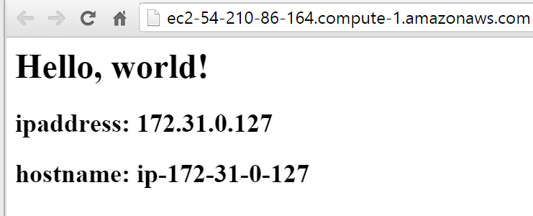
Verify that the New Node Serves the Page
Notes:
Verify that the node serves up the default html page that contains the node's internal IP address and hostname.

Slide 10
Lab: Update the Proxy
Update the wrapped proxy server cookbook to include the new web node as a member.
Upload that cookbook to the Chef Server
Login to that system and run chef-client
Verify that the proxy server delivers traffic to both web server nodes.
Notes:
TBD: Need notes

Slide 11
Lab: Add the Other Web Server to Proxy
~/chef-repo/cookbooks/myhaproxy/recipes/default.rb
node.default['haproxy']['members'] = [{
"hostname" => "ec2-204-236-155-223.us-west-1.compute.amazonaws.com",
"ipaddress" => "ec2-204-236-155-223.us-west-1.compute.amazonaws.com",
"port" => 80,
"ssl_port" => 80
},{
"hostname" => "ec2-54-176-64-173.us-west-1.compute.amazonaws.com",
"ipaddress" => "ec2-54-176-64-173.us-west-1.compute.amazonaws.com",
"port" => 80,
"ssl_port" => 80
}
]
include_recipe "haproxy::default"
Notes:
Add the second web server (node3) to the Proxy server's members list. You may need to run 'knife node show node3 -a cloud' to get the hostname and ipaddress values.

Slide 12
Lab: Update the Version
~/chef-repo/cookbooks/myhaproxy/metadata.rb
name 'myhaproxy'
maintainer 'The Authors'
maintainer_email 'you@example.com'
license 'all_rights'
description 'Installs/Configures myhaproxy'
long_description 'Installs/Configures myhaproxy'
version '0.2.0'
depends 'haproxy', '~> 1.6.6'
Notes:
Update the version number in ~/chef-repo/cookbooks/myhaproxy/metadata.rb.

Slide 13
Lab: CD and Then Run berks install
$ cd ~/chef-repo/cookbooks/myhaproxy
$ berks install
Resolving cookbook dependencies...
Fetching 'myhaproxy' from source at .
Fetching cookbook index from https://supermarket.chef.io...
Using build-essential (2.2.3)
Using cpu (0.2.0)
Using haproxy (1.6.6)
Using myhaproxy (0.2.0) from source at .
Notes:
Change to ~/chef-repo/cookbooks/myhaproxy and then run 'berks install' to install the myhaproxy cookbook.

Slide 14
Lab: Upload the Cookbook to Chef Server
$ berks upload
Uploaded build-essential (2.2.3) to: 'https://api.opscode.com:443/organizations/steveessentials2'
Uploaded cpu (0.2.0) to: 'https://api.opscode.com:443/organizations/steveessentials2'
Uploaded haproxy (1.6.6) to: 'https://api.opscode.com:443/organizations/steveessentials2'
Uploaded myhaproxy (0.2.0) to: 'https://api.opscode.com:443/organizations/steveessentials2'
Notes:
Run 'berks upload' to upload the myhaproxy cookbook to Chef Server.

Slide 15
Lab: Converge the Cookbook
$ knife ssh "*:*" -x USERNAME -P PWD "sudo chef-client"
ec2-54-210-192-12.compute-1.amazonaws.com Starting Chef Client, version 12.3.0
ec2-54-175-46-24.compute-1.amazonaws.com Starting Chef Client, version 12.3.0
ec2-54-210-86-164.compute-1.amazonaws.com Starting Chef Client, version 12.3.0
ec2-54-210-192-12.compute-1.amazonaws.com resolving cookbooks for run list: ["myhaproxy"]
ec2-54-175-46-24.compute-1.amazonaws.com resolving cookbooks for run list: ["apache"]
ec2-54-175-46-24.compute-1.amazonaws.com Synchronizing Cookbooks:
ec2-54-175-46-24.compute-1.amazonaws.com - apache
ec2-54-175-46-24.compute-1.amazonaws.com Compiling Cookbooks...
ec2-54-210-192-12.compute-1.amazonaws.com Synchronizing Cookbooks:
ec2-54-175-46-24.compute-1.amazonaws.com Converging 3 resources
ec2-54-175-46-24.compute-1.amazonaws.com Recipe: apache::server
ec2-54-210-192-12.compute-1.amazonaws.com - build-essential
Notes:
Converge the cookbook by logging into that node and running 'sudo chef-client' or remotely administer the node with the 'knife ssh' command as shown here.

Slide 16
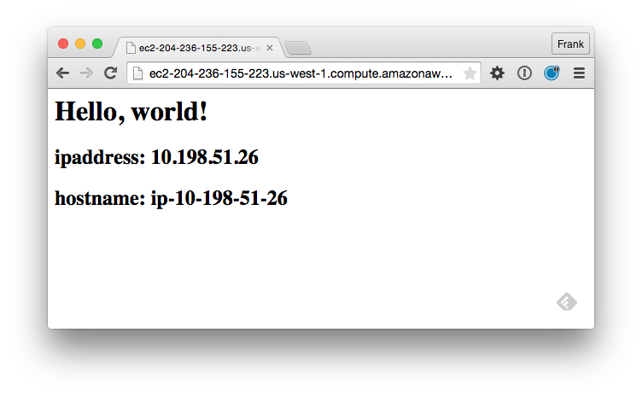

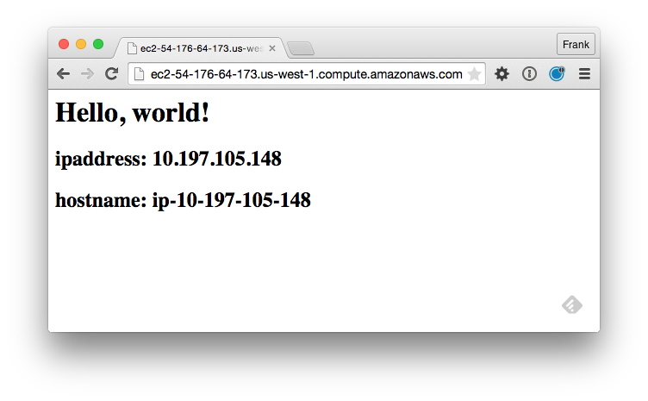
Lab: Test the Proxy
Notes:
Point a web browser to the URL of your Proxy server and then click Refresh a few times. You should see each of your web server's HTML page as the Proxy server switches between each web server.

Slide 17

Lab: Test the Proxy

Slide 18
Discussion
What questions can we help you answer?

